Slide 1


Human Activity Recognition
MIS 637 Knowledge Discovery & Data Mining; 2018 Spring
Prof. M. Daneshmand
Taru Tak
ttak@stevens.edu

Slide 2
Outline
Motivation (Business Understanding & Research Phase)
Dataset Information ( Data Understanding phase)
Sample Data
Data Preparation (Data preparation Phase)
Visualization
Tools
Methodology (Modelling Phase)
Model Evaluation (Evaluation Phase)
Conclusion

Slide 3
Motivation
The human ability to recognize another person’s activities is one of the main subjects of study of the scientific areas of computer vision and machine learning. As a result of this research, many applications, including video surveillance systems, human-computer interaction, and robotics for human behavior characterization, require a multiple activity recognition system.
the recognition of human activities has become a task of high interest within the field, especially for medical, military, and security applications. For instance, patients with diabetes, obesity, or heart disease are often required to follow a well defined exercise routine as part of their treatment. Therefore, recognizing activities such as walking, running, or cycling becomes quite useful to provide feedback to the caregiver about the patient’s behavior.
Likewise, patients with dementia and other mental pathologies could be monitored to detect abnormal activities and thereby prevent undesirable consequences .
In tactical scenarios, precise information on the soldiers’ activities along with their locations and health conditions, is highly beneficial for their performance and safety. Such information is also helpful to support decision making in both combat and training scenarios.

Slide 4
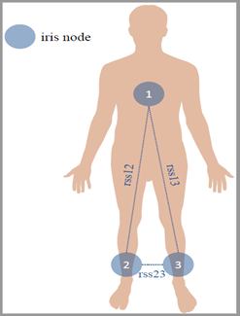
Dataset Information
Sensor placement
Find it here: https://archive.ics.uci.edu/ml/datasets/Activity+Recognition+system+based+on+Multisensor+data+fusion+(AReM)
This dataset represents a real-life benchmark in the area of Activity Recognition applications.The classification tasks consist in predicting the activity performed by the user from time-series generated by a Wireless Sensor Network (WSN). From the raw data we extract time-domain features to compress the time series and slightly remove noise and correlations.
The three couples of WSN nodes (i.e. Chest-Right Ankle, Chest-Left Ankle, Right Ankle-Left Ankle). The features include the mean value and standard deviation for each reciprocal RSS reading from worn WSN sensors.
The dataset contains 7 folders that represent seven types of activities. In each folder, there are multiple files each of which represents an instant of a human performing an activity. Each file contains 6 time series collected from activities of the same person. There are 88 instances in the dataset, each of which contains 6 time series and each time series has 480 consecutive values.

Slide 5
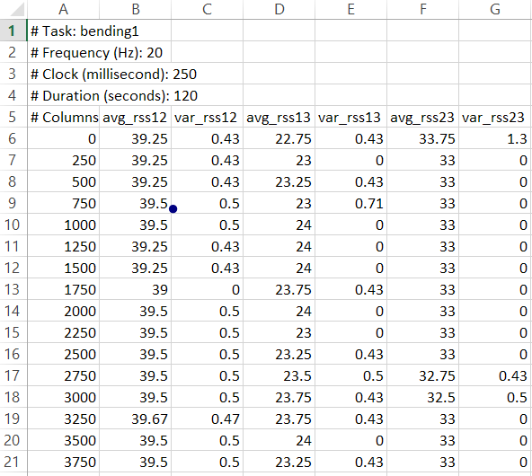
Sample Data
Attribute Information:
For each sequence, data is provided in comma separated value (csv) format.
In each file, each row corresponds to a time step measurement (in temporal order) and contains the following information:
avg_rss12, var_rss12, avg_rss13, var_rss13, avg_rss23, var_rss23
, where avg and var are the mean and variance values over 250 ms of data, respectively.
Target data:
Target data is provided as the containing folder name.
7 classes - Bending1, Bending2, Cycling, Lying, Sitting, Standing, Walking.

Slide 6
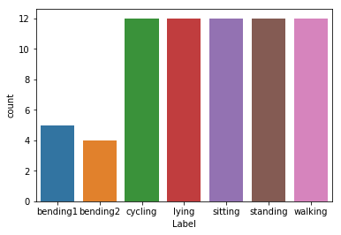
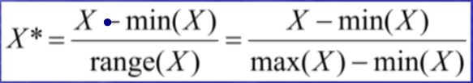
Data Preparation
Classification of time series usually needs extracting features from them. In this notebook I have taken in account common features like min, mean, std, max, 25% , 50% and 75%. We use these extracted features to classify our activities
.Our dataset had labels missing from them. The function "feature_def" is responsible for reading the csv files, extracting features and subsetting the corresponding features of the 6 times series into a single row.
The Features for the train_set now becomes a dataframe of size 69*49, where 69 is the number of train files and 43 columns is due to 7 features of 6 times series and one label column.
Normalization : We use Min-Max scaler to bring the features between the scale 0 to 1.
Train set has size 69*43 and test set has size 19*43.
We only had 88 files so in order to get more data I have subdivided our times series into L parts to get more train and test data.

Slide 7
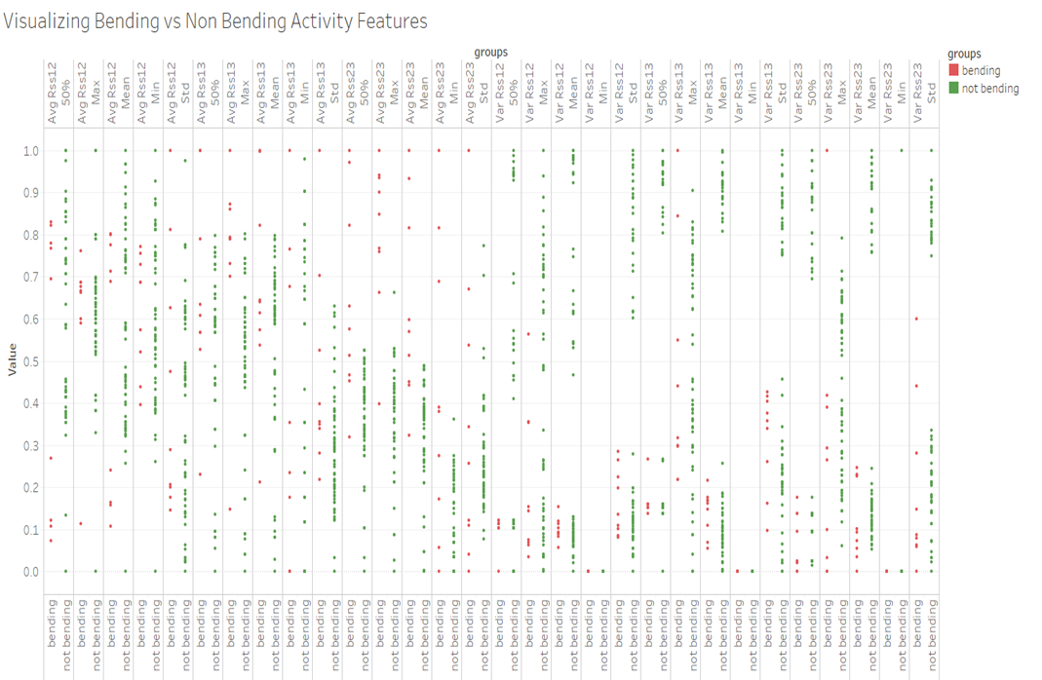

Slide 8
Tools
I have implemented the Project in Python Version 3. Using Anaconda Jupyter Notebook.
Popular Libraries have been utilized
Numpy: fast computation library for linear algebra
Pandas: Simple and efficient dataframe manipulation
Matplotlib , Seaborn : Plots
Sklearn : for modelling, cross validation and evaluation

Slide 9
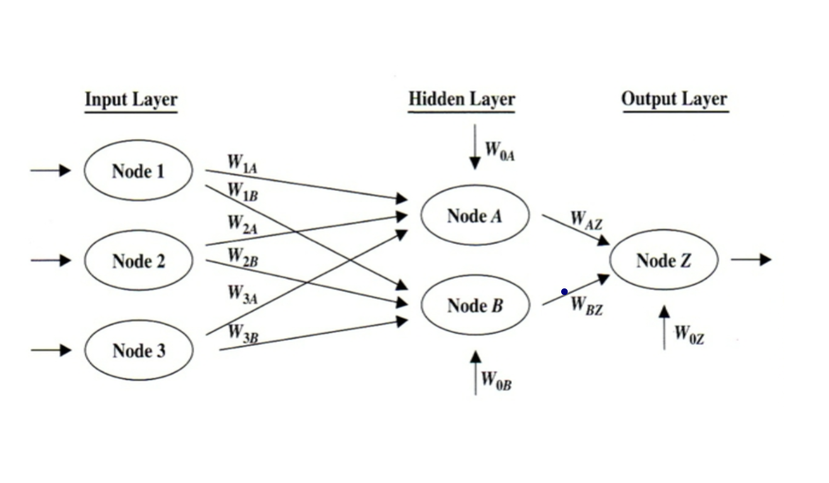
Methodology
Model used : Artificial Neural Networks

Slide 10
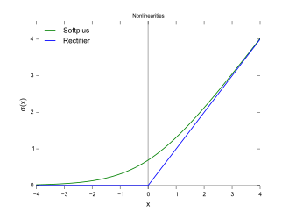
ANN
For simplicity a model with 1 hidden layer is chosen.
Our hidden layer contains 100 nodes.
We use constant learning rate initialized at 0.001.
Our activation function in Relu or softmax function.
f(x)=log(1+\exp x)

Slide 11
Model Evaluation
We use the following Metrics to evaluate the accuracy of our models
Accuracy
Confusion Matrix
Recall, Precision and F1 score

Slide 12
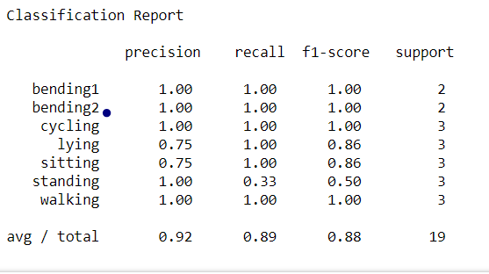
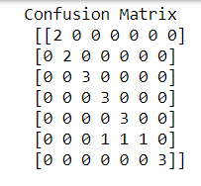
Results
Our Final Accuracy is 89.47%

Slide 13
Conclusion
Artificial Neural Networks is state of the art supervised learning technique which can easily be used for multi-label classification problems
The number of hidden layers, nodes, activation function and learning rate drastically effects the functioning of NN properly and ability to model target series with certain inputs.
For the parameters and techniques used kindly refer the Python Notebook attached.

Slide 14
Thank You

Slide 15
References and Citations
http://dataaspirant.com/2017/05/15/implement-multinomial-logistic-regression-python/
http://scikit-learn.org/stable/modules/generated/sklearn.linear_model.LogisticRegression.html
http://scikit-learn.org/stable/modules/generated/sklearn.naive_bayes.MultinomialNB.html
https://sebastianraschka.com/faq/docs/evaluate-a-model.html

